Slide 1
ASME Hands On
October 2015

Slide 2
Prerequisite

Slide 3
Prerequisite
Only 2 prerequisites are necessary to operate with the ASME Unit, the first one is the Hw Tool that will be connected to the ASME trough the Serial Wire Debug (SWD) Port; the second is the Sw IDE that could be used both to create the code and debug it in conjunction with the Hw Tool . The Sw tool is totally free, while the 2 Hw Tools have a very limited cost, around 100$.

Slide 4
Prerequisite
Hw prerequisite:
Atmel-ICE is a powerful development tool for debugging and programming Atmel ARM® Cortex®-M based Atmel SAM and AVR® microcontrollers with on-chip debug capability. More information on the Atmel-ICE home page (http://www.atmel.com/tools/atatmel-ice.aspx).
Alternately it is possible to use the Atmel SAM-ICE . Atmel SAM-ICE™ is a JTAG emulator designed for Atmel SAMA5, SAM3, SAM4, SAM7 and SAM9 ARM® core-based microcontrollers, including the Thumb® mode. More information on the SAM-ICE home page(http://www.atmel.com/tools/ATMELSAM-ICE.aspx).

Slide 5
Prerequisite
Sw Prerequisite:
Atmel® Studio 6 is the integrated development platform (IDP) for developing and debugging Atmel ARM® Cortex®-M and Atmel AVR® microcontroller (MCU) based applications.
It is fully downloadable from the Atmel Studio6 home page, after a free registration to the Atmel network. (http://www.atmel.com/microsite/atmel_studio6/)

Slide 6
Environment setup

Slide 7
Environment setup
HW Tool Setup
HW Setup isn’t necessary, as it is ready to use.
The system will automatically detect if a new FW is present for the HW at the first connection (more in the Debugging session chapter)

Slide 8
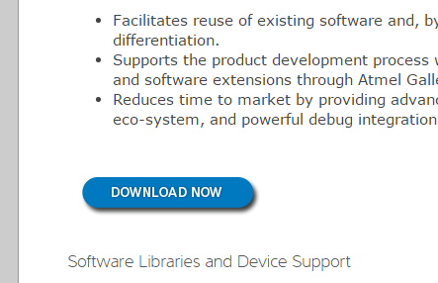
Environment setup
SW Tool Setup
First of all it is necessary to download the SW: go to the Home page (http://www.atmel.com/microsite/atmel_studio6/) and press the “Download Now” button.

Slide 9
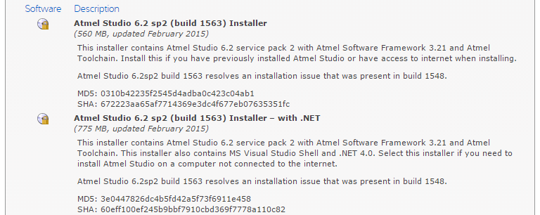
Environment setup
SW Tool Setup
You will be redirected to the page where it is possible to download the Sw (select the disk icon). There are 2 choices: with or without “.NET”. Considering that the Studio6 needs .NET to work, you should download the full package if the host pc does not have .NET

Slide 10
Environment setup
Clicking on the correct disk icon you will land on the Atmel subscription form (useful to activate many other downloads, such as examples or add-ons of Studio6), but it is also possible to download the SW as a guest user.
When the setup file is on your pc, run it and follow the few steps required for a complete installation of the Sw tool.

Slide 11
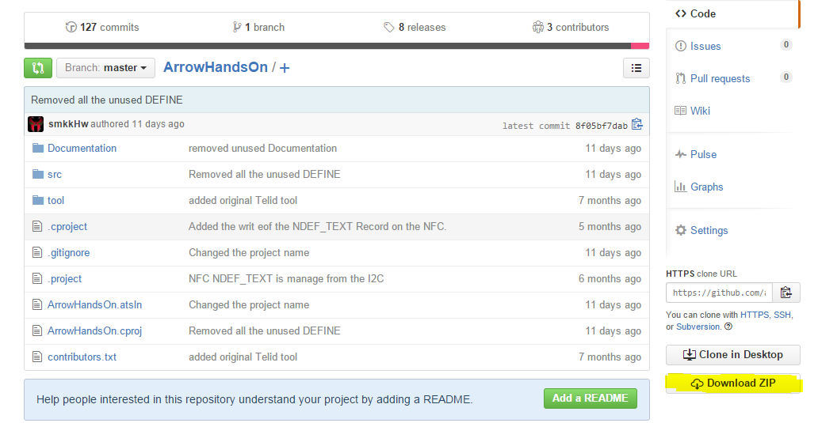
Environment setup
SW example Installation
The example Sw is downloadable trough GitHub on (https://github.com/axelelettronica/ArrowHandsOn) by pressing the “Download Zip” button. It is not required to be subscribed to GitHub.
The zip is completed with source and project file for Atmel Studio 6. The Software has a GNU license, this means that everyone could download and use.

Slide 12
Environment setup
Unzip it on a directory, it is suggest to use the default Studio6 project directory, which normally is under
“C:\Users\<pc user>\Documents\Atmel Studio”,
but it is not required and could be unzipped on any yours preferred directory.

Slide 13
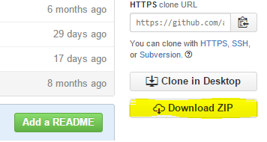
Environment setup
Download SW Example
The Sw of this Hands-on is available under github on the following repository:
axelelettronica/ArrowHandsOn
Open the page and download the free example code

Slide 14
Code explanation

Slide 15
Code explanation
This example code shows how to collect all the information from the set of sensors, using the I2C bus.
How to manage the IO/Extender.
Read the GPS signal and send messages over the SFX Network using the internal UART.
The Arduino digital RS232 channel is used as a console with some command for sensors, GPS, SFX
It has to be intend as a reference code and not as a final implementation.
Currently the BLE is out of this example code

Slide 16
FreeRtos
The example project is based on the FreeRTOS OS.
All the tasks are under the directory sme/tasks.
The most important task is the control task in the file sme_controller.c
This is the task that dispatch the internal message received by the button interrupt or IO/extended.
The other tasks are to manage the RX char coming from the UARTs, one task each for SFX & GPS.

Slide 17
Startup
At the startup, after the normal component initialization, the application
runs on all the sensors to initialize them (where required) or check their presence with a specific message, sme_i2c_mgr_init in sme/model/sme_model_i2c.c
This procedure marks as ready those component that answer correctly and could be used by the application.
It also prepare a significant function that is used by the functionalities called “send all sensor data”.

Slide 18
Button pressed
The detection of the button pressed is managed on the file sme/behavior/sme_button_behavior.c by:
The function run under the controller task execution.
This because at the interrupt detection a message is sent to that task and release immediately the ISR.
It is possible to change the behavior of the button changing the call from there
Function | Button
button1Execution | First
button2Execution | Second

Slide 19
Atmel Studio 6

Slide 20
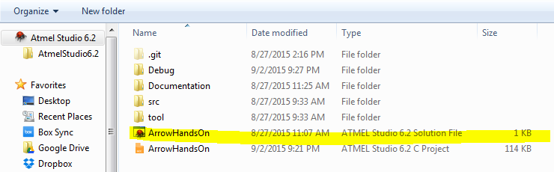
Atmel Studio 6 Project open
Run Atmel Studio6 application on your PC (if it will require to download the new Framework, skip that part for this example).
After the splash screen it will be show the “Start Page” of the IDE. Select “Open Project…” and goes to the directory on where did you unzip the example (do nothing if you choose the Atmel Studio6 default directory).
Select the file “HarrowHandsOn … Solution File” (the one with the Studio6 Icon)

Slide 21
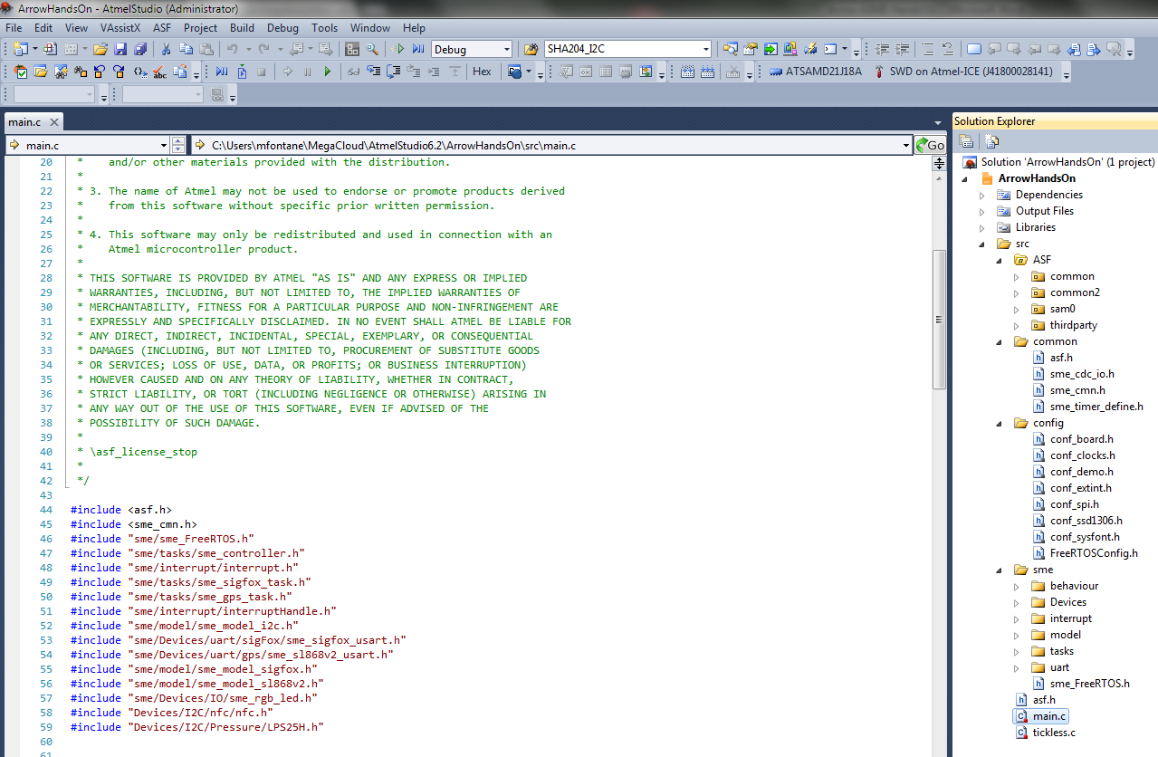
Atmel Studio 6 Project open
Finally you have the Sw ready for changes or debugging.
The IDE is divided in many frames in different position; the most important are the right and the left one, on which are visible the source frames and the project frame.

Slide 22

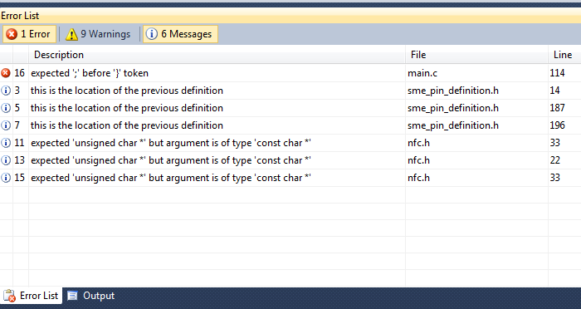
Atmel Studio 6 Project Compiling
To compile the SW, before download it on the ASME, there are two ways: 1) Build Solution 2) build project For this examples both are identical, just use build project which is more correct. Build solution is for those complex projects that require to be split in more small projects. Any Blocking Errors or simple Warning will be listed on the bottom frame.

Slide 23
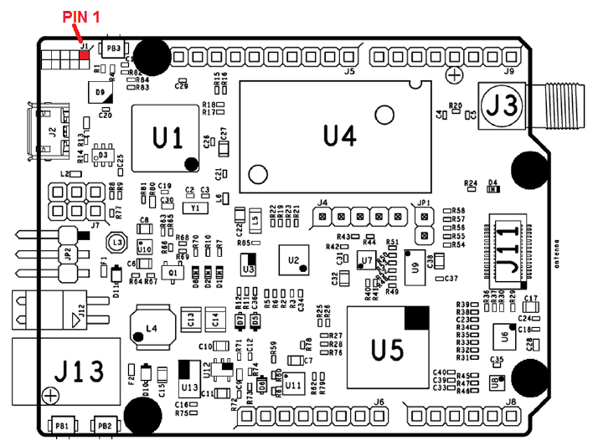
Atmel Studio 6 Debugging session
Hw connection
ATTENTION !!!!!!! the SWD has a not polarized connector, this means that it could be possible to insert the cable on the wrong side. The red wire shall be connected to pin1

Slide 24
Atmel Studio 6 Debugging session
Sw connection
Premere il bottone del play.
Il Sistema fara apparire la pagina del progetto chiedendo che tipo di debugger si vuole utilizzare.
Selezionare il proprio HW (SAM-ICE or Atmel-ICE), solo la prima potrebbe essere che verra’ chiesto il download del nuovo FW, dare il consenso ed aspettare la fine del download.

Slide 25
ASME & Arduino

Slide 26
Prepare ASME to work with Arduino IDE
It is possible to use the ASME in Arduino mode, in this case it will be programmed in the identical way like all the others Arduino units, no Atmel Studio6 is required, instead, the new Arduino is needed.
Prerequisite is to have the Arduino Ide Ide (Ver 1.6.5 or newer) and the SmartEverything core already installed and the ASME user guide well describe how to do.
It is no part of this Hands On going deeper in detail of the Arduino IDE, this is available on the UserGuide downloadable from the web-side of the ASME

Slide 27
References

Slide 28
References
Asme Web Site (http://www.smarteverything.it/)
Asme User Guide v. 1.0 (http://www.smarteverything.it/?smd_process_download=1&download_id=1798)
Atmel Studio6 (http://www.atmel.com/microsite/atmel_studio6/)
Arduino Home Page (https://www.arduino.cc/)

Slide 29
Q&A

Slide 30
THANK YOU
October 2015

